Slide 1
Port4 3D Beam Pattern Compare With SIM

Slide 2
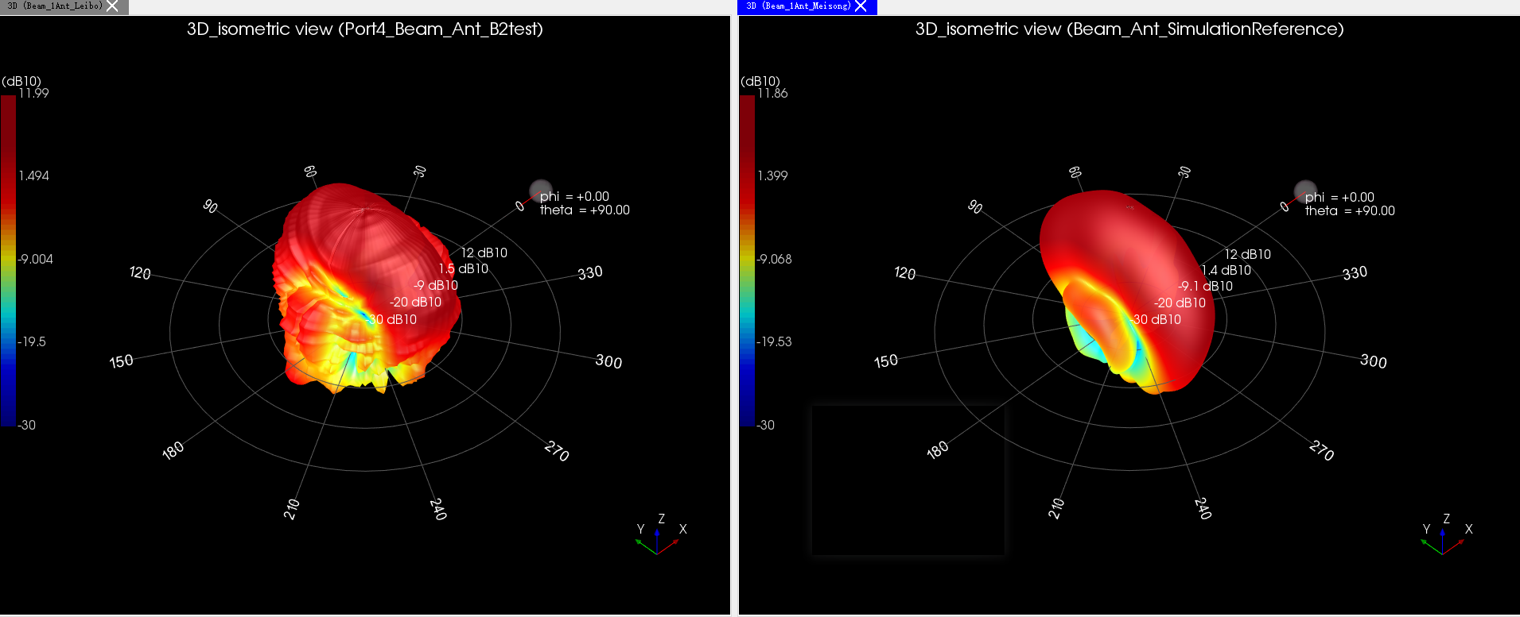
Port4 test isometric view VS sim

Slide 3
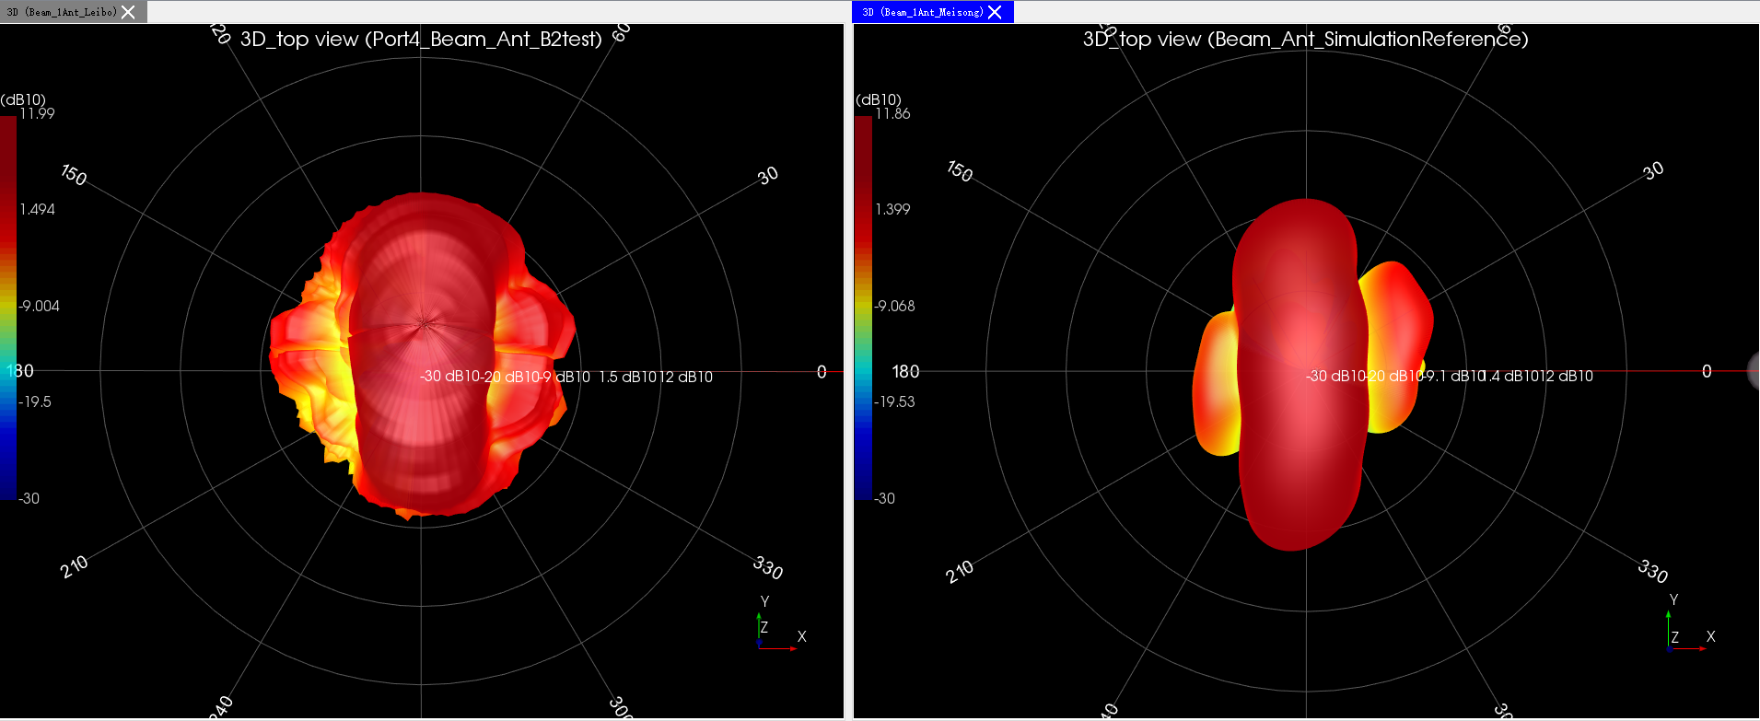
Port4 test top view VS sim

Slide 4
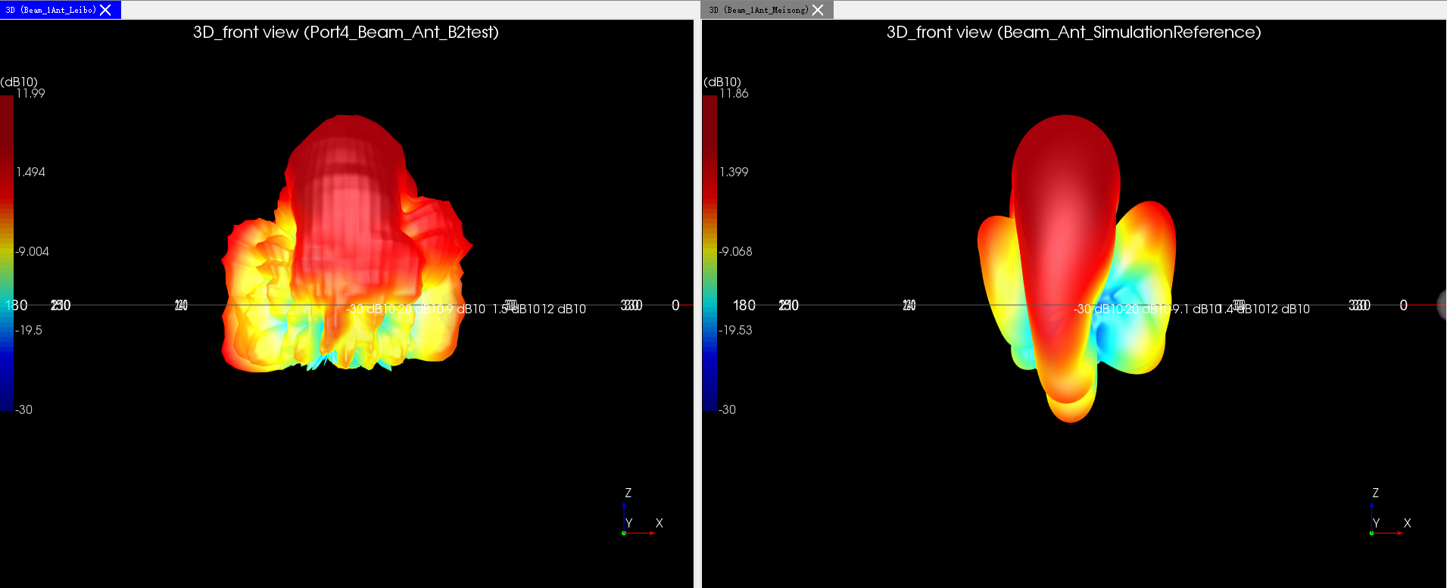
Port4 test front view VS sim

Slide 5
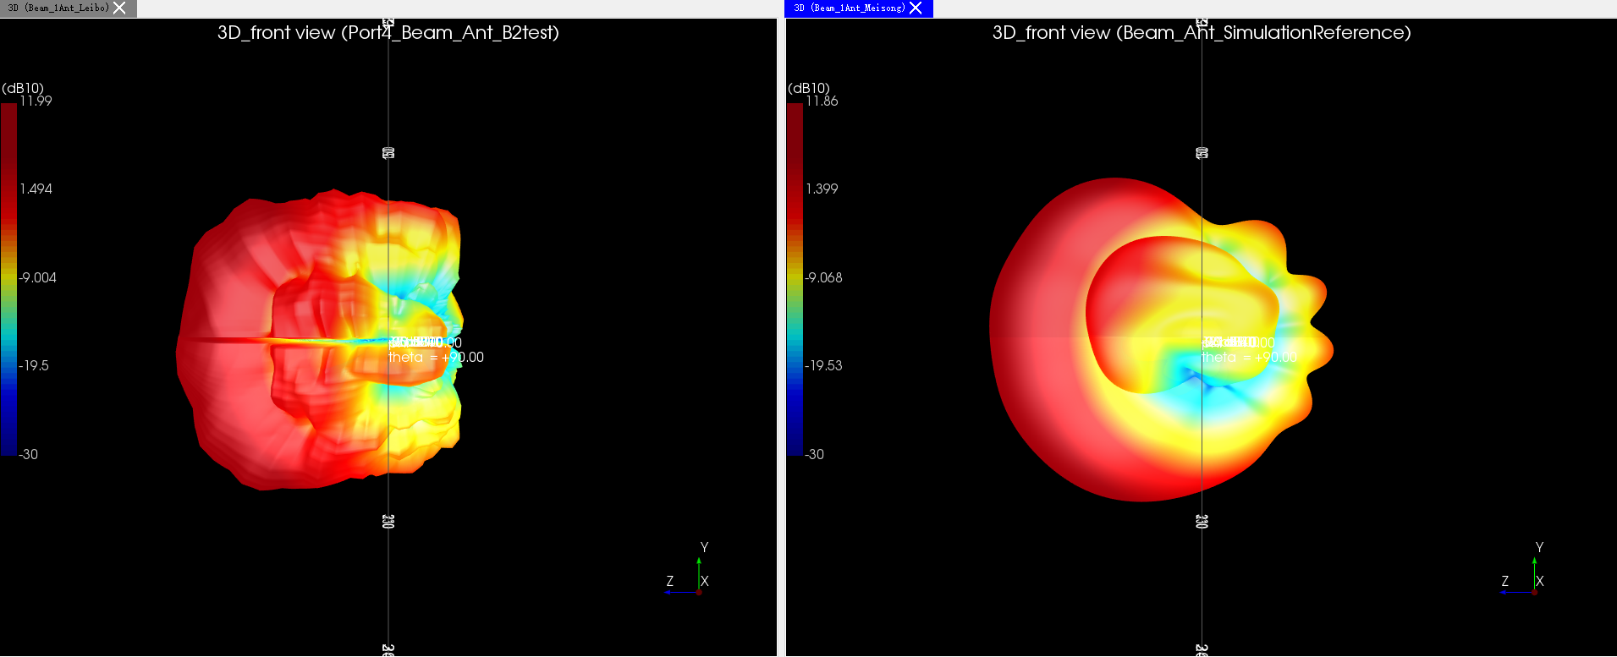
Port4 test side view VS sim

Slide 6
Port1 3D Beam Pattern Compare With Port4

Slide 7
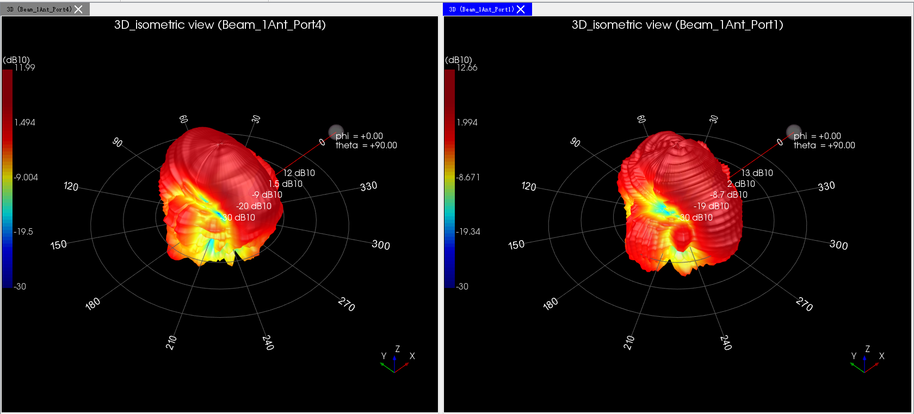
Port4 test isometric view VS Port1

Slide 8
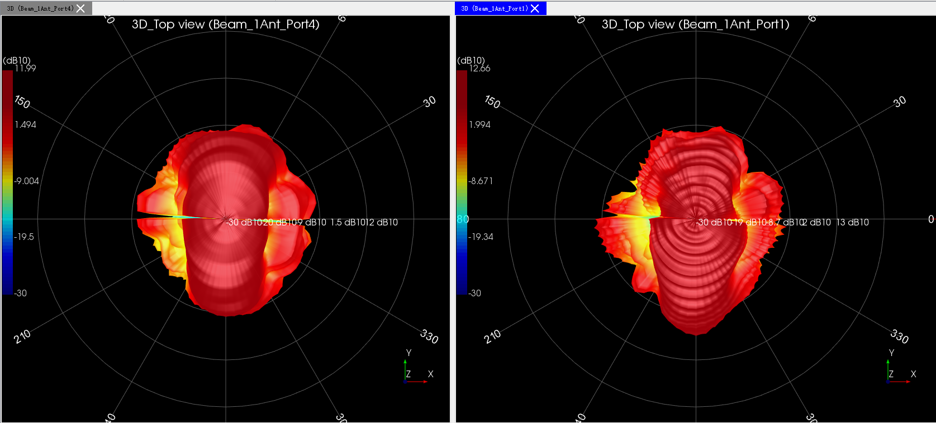
Port4 test top view VS port1

Slide 9
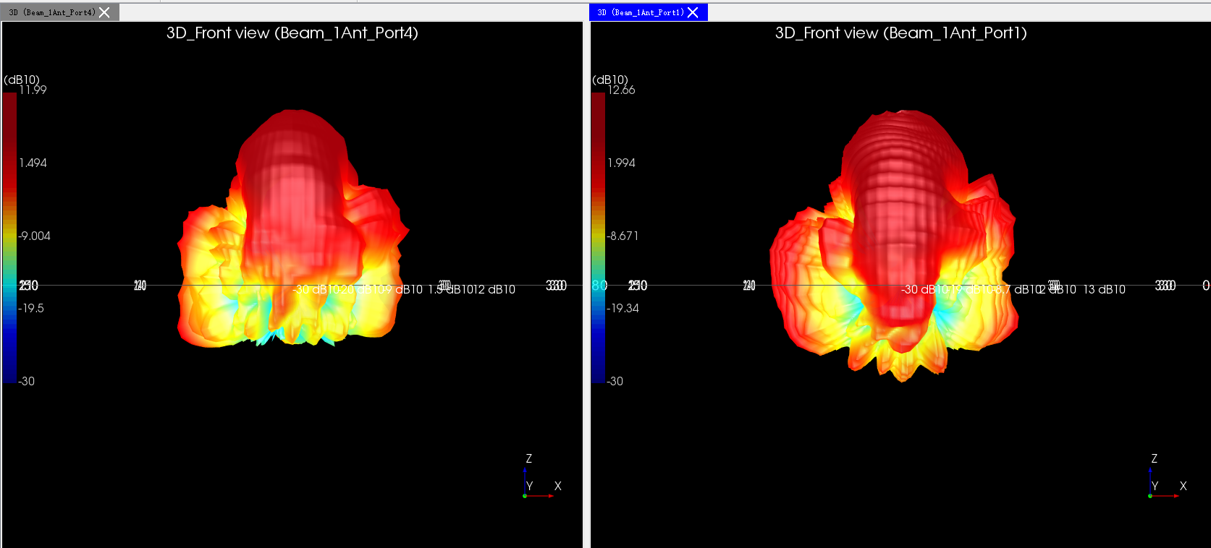
Port4 test front view VS port1

Slide 10
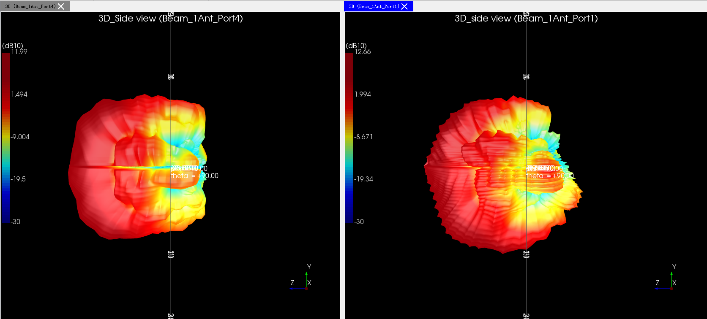
Port4 test side view VS port1

Slide 11
B2 坐标系，satimo坐标系以及systemvue坐标转换

Slide 12
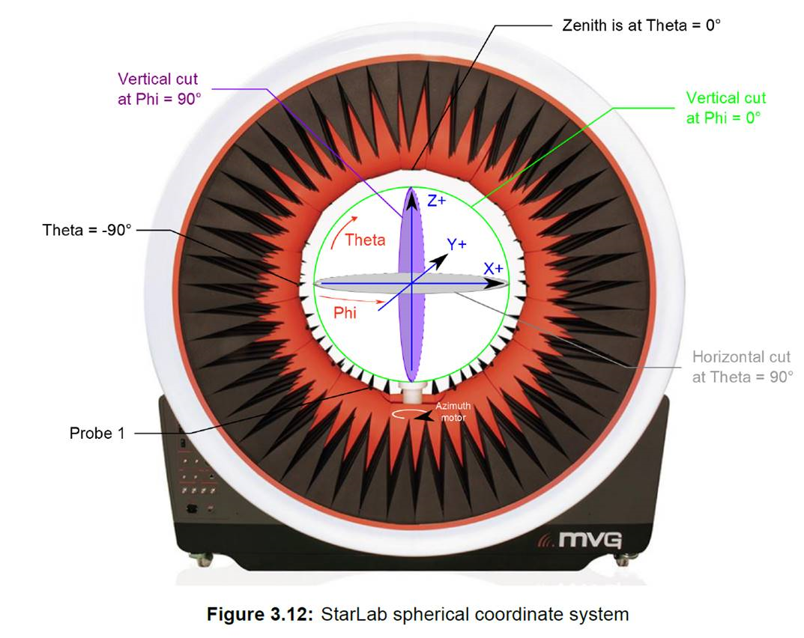
Satimo暗室结构
Satimo暗室定义：
Theta:与Z轴夹角，顺时针为正，
范围[0,360]
Phi：与X轴夹角，逆时针为正，
范围[0,180]
SV中要求：
Theta:与Z轴夹角，范围[0,180]
Phi：与X轴夹角，范围[0,360]

Slide 13
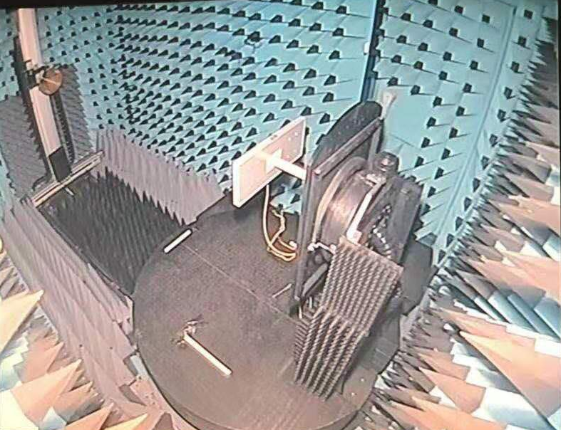
B2暗室结构
y
z
x
B2暗室：
Theta:与Z轴夹角，顺时针为正， 范围[-180,180]
Phi：与X轴夹角，逆时针为正，
范围[-90，90]（Phi=-90度对应satimo暗室Phi=0度）
图为B2暗室结构图
此时Theta=0,phi=0
B2暗室路损：53dB

Slide 14
B2坐标系转Satimo坐标系
z
y
z
y
B2坐标系
x
satimo坐标系
x
Phi=0切面是绕着发射天线长边旋转一周
Phi=0切面是绕着发射天线短边旋转一周
B2坐标系相当于把satimo的放倒90度，然后把B2暗室Phi=-90与satimo的Phi=0对应上即可（即相当于Phi(satimo)=Phi(B2)+90）

Slide 15
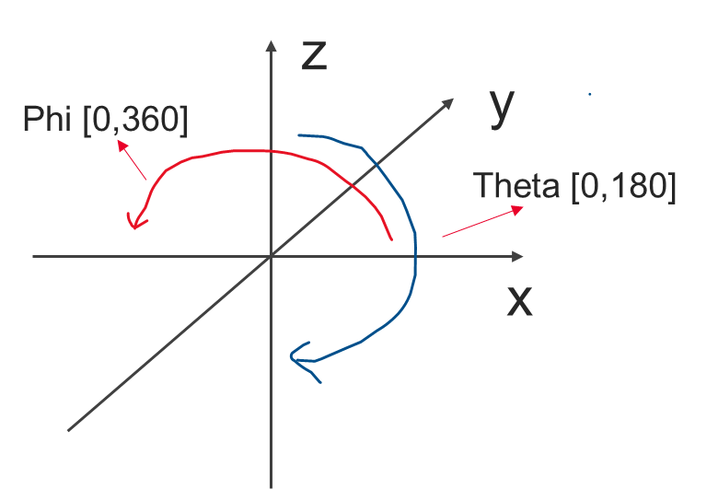


Satimo坐标转systemvue坐标
z
y
Phi [0,180]
Theta [-180,180]
x
Satimo坐标
systemvue坐标
Phi [0,180] , Theta [0,180]
Phi [0,180] , Theta [0,-180]
Phi [0,180] , Theta [0,180]
Phi [180,360] , Theta [0,180]
Systemvue的Phi [0,180] ,Theta [0,180]转换是不变的，Phi [180,360],Theta [0,180]对应于y轴负半球，即对应于satimo 坐标的Theta[0,-180]，即对Theta[-180,0]数据反转即可

Slide 16
Port4 initial data compare with change data

Slide 17
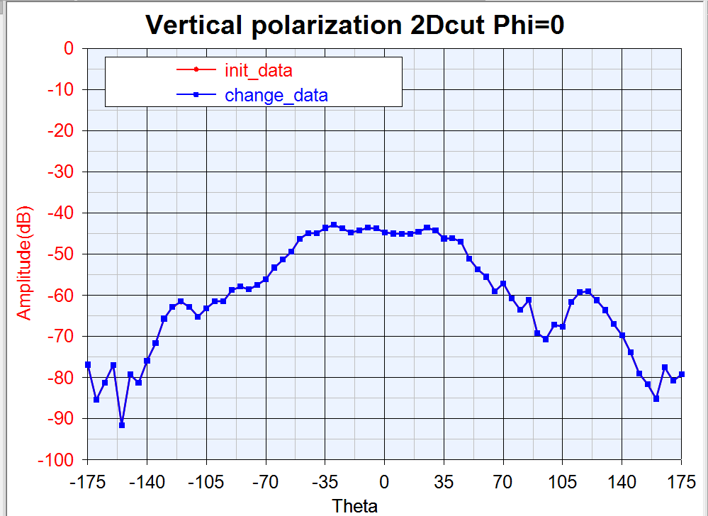

Slide 18
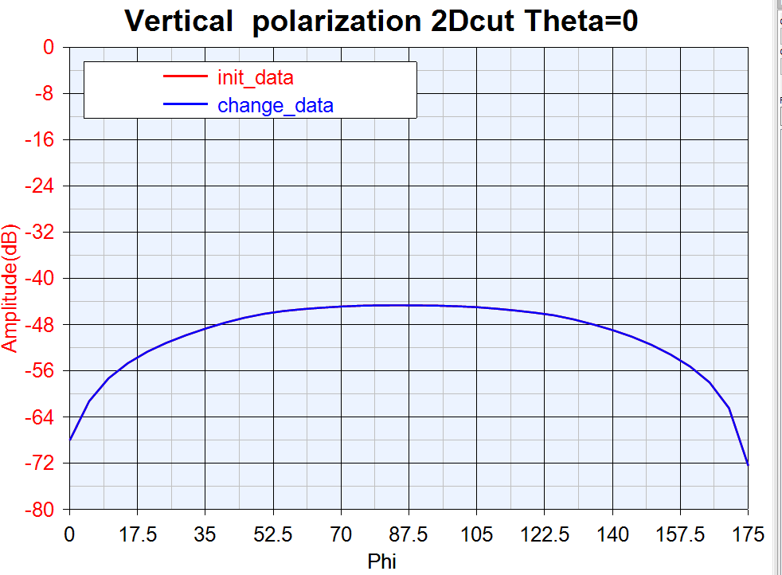

Slide 19
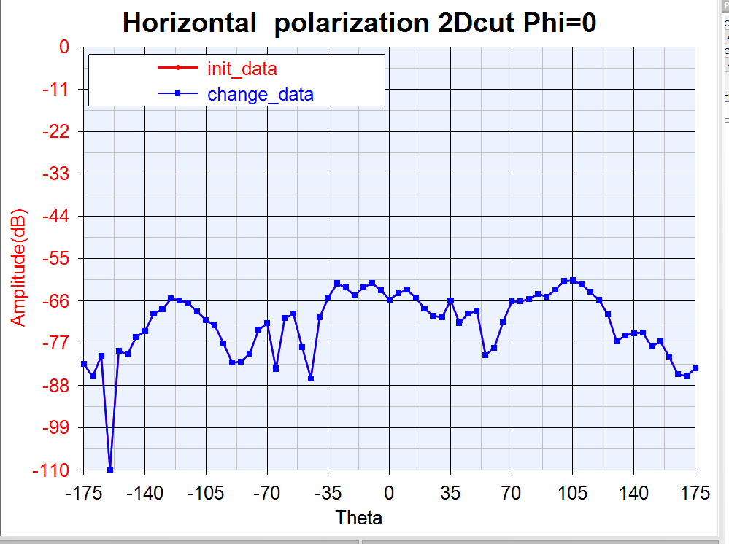

Slide 20
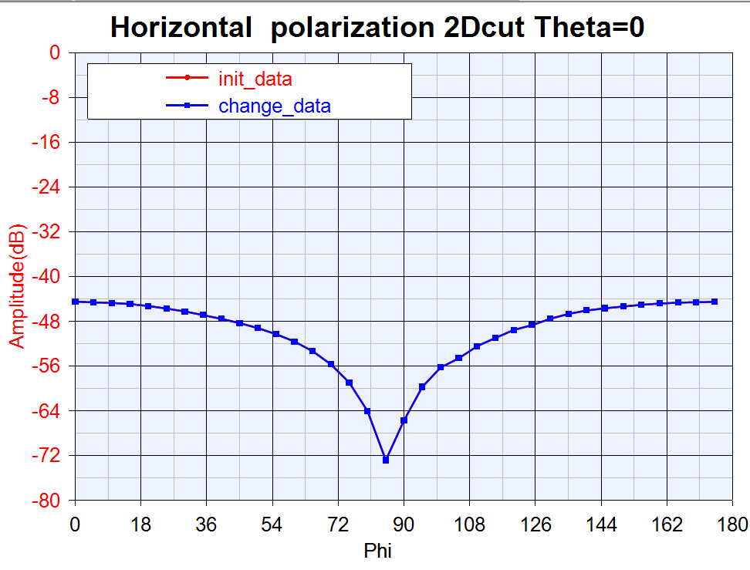

Slide 21
Port1 initial data compare with change data

Slide 22
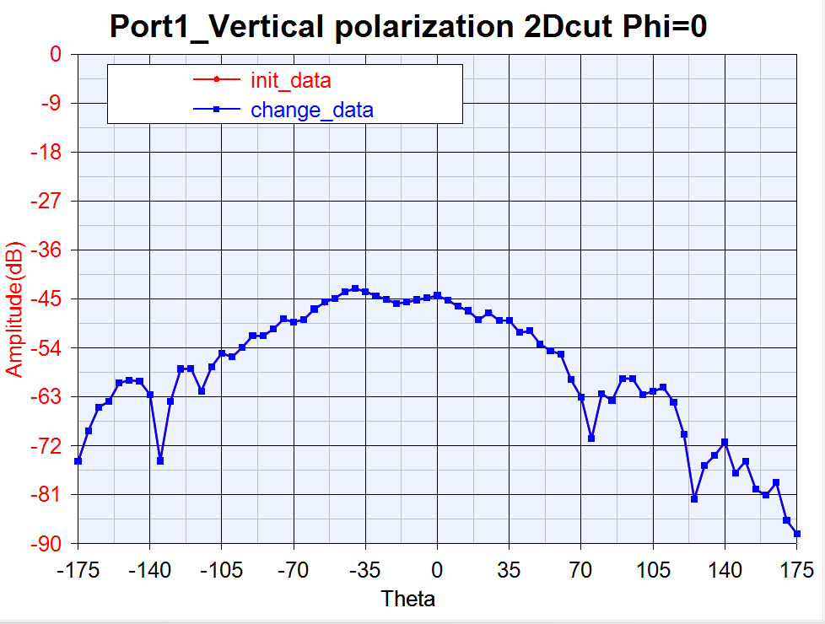

Slide 23
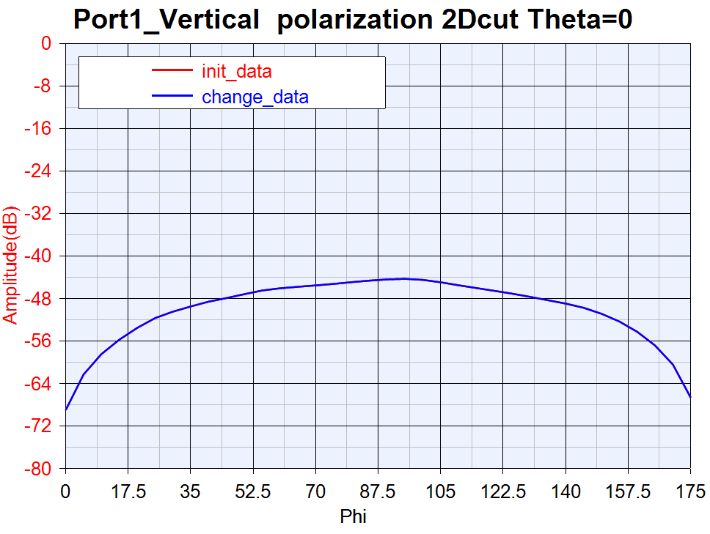

Slide 24
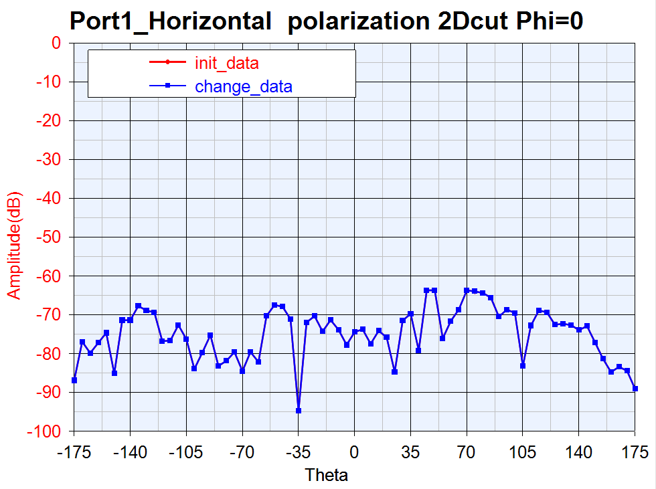

Slide 25
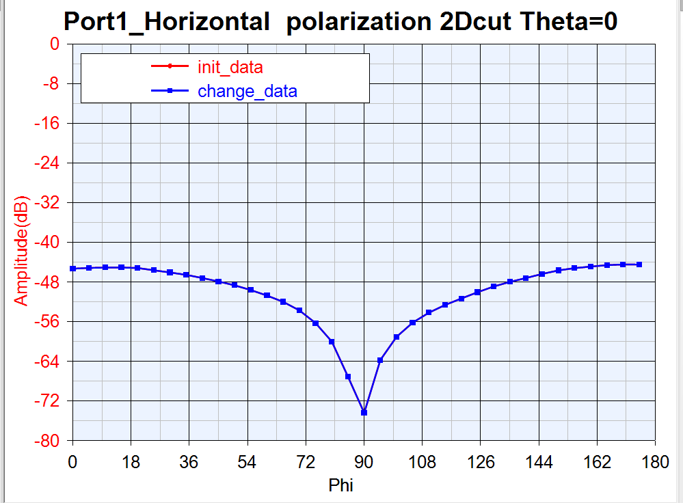

Slide 26
Port4 2D cut compare with Port1

Slide 27
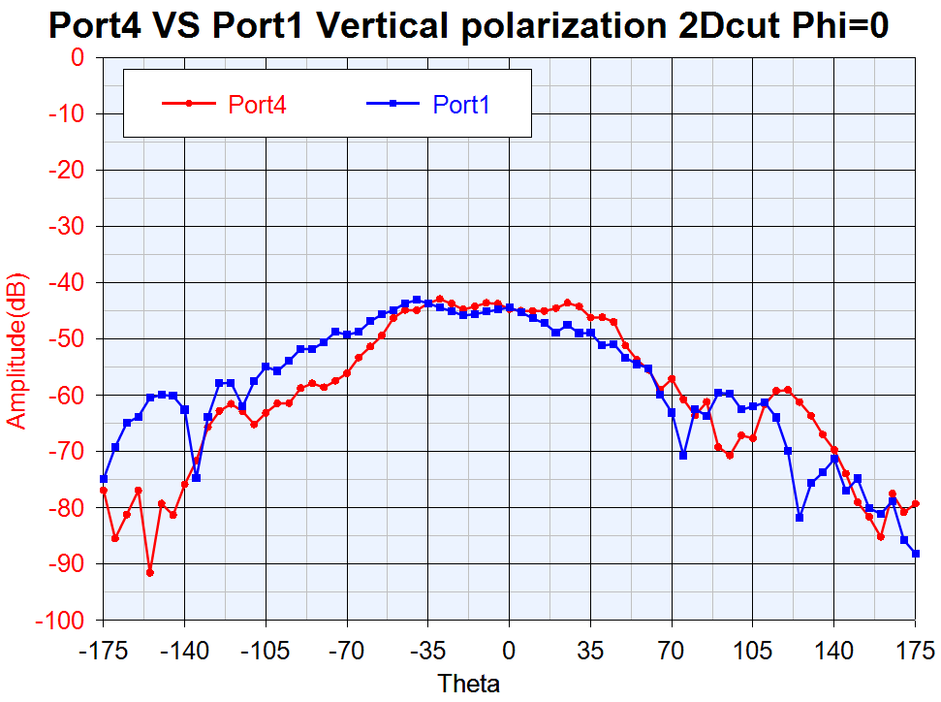

Slide 28
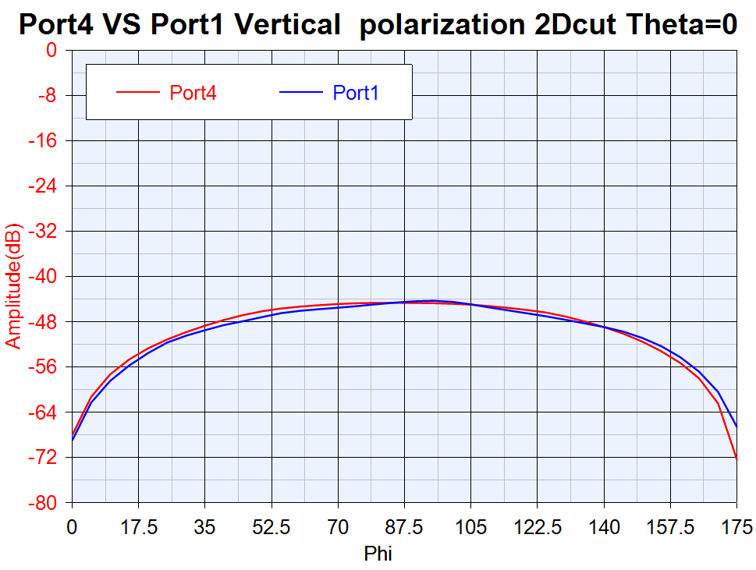

Slide 29
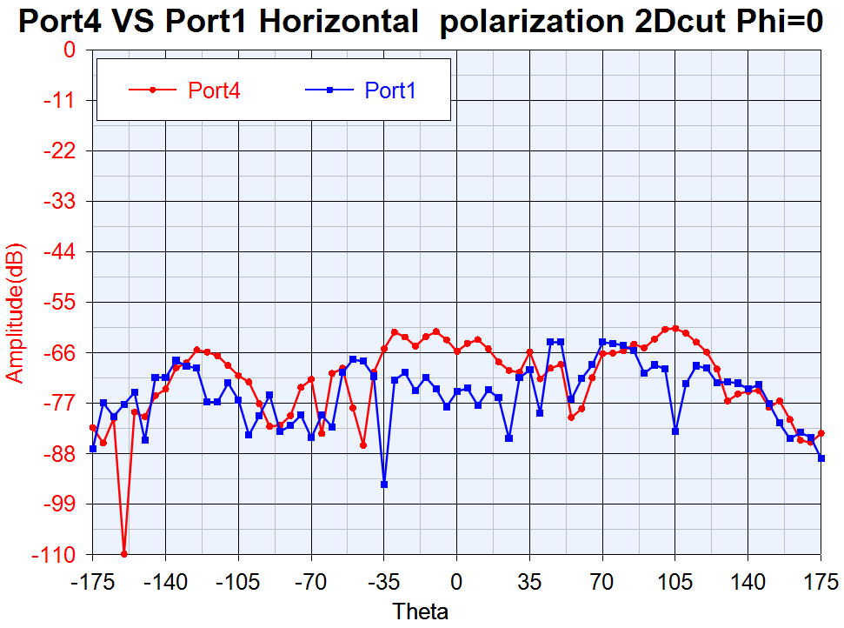

Slide 30
